Slide 1
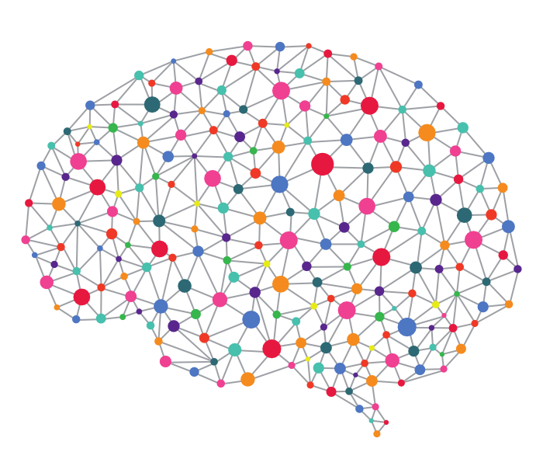

Squeezing Deep Learning into mobile phones
- A Practitioners guide
Anirudh Koul
Notes:
https://hongkongphooey.wordpress.com/2009/02/18/first-look-huawei-android-phone/
https://medium.com/@startuphackers/building-a-deep-learning-neural-network-startup-7032932e09c

Slide 2

Anirudh Koul , @anirudhkoul , http://koul.ai
Project Lead, Seeing AI
Applied Researcher, Microsoft AI & Research
Akoul at Microsoft dot com
Currently working on applying artificial intelligence for productivity, augmented reality and accessibility
Along with Eugene Seleznev, Saqib Shaikh, Meher Kasam
i

Slide 3
Why Deep Learning On Mobile?
Latency
Privacy
i

Slide 4

Mobile Deep Learning Recipe
Mobile Inference Engine + Pretrained Model = DL App
(Efficient)
(Efficient)
i

Slide 5
Building a DL App in _ time

Slide 6
Building a DL App in 1 hour
Notes:
No, don’t do it right now. Do it in the next session.

Slide 7
Use Cloud APIs
Microsoft Cognitive Services
Clarifai
Google Cloud Vision
IBM Watson Services
Amazon Rekognition
i

Slide 8
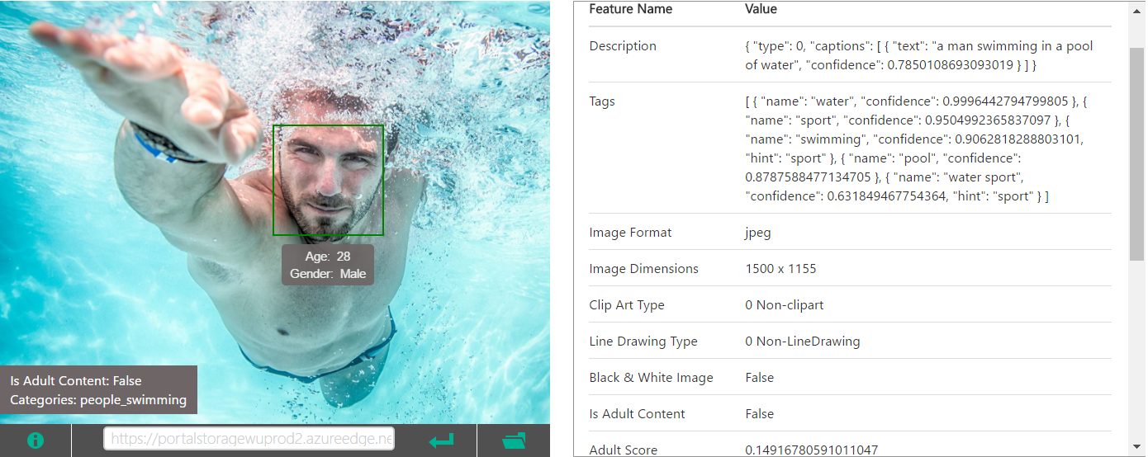
Microsoft Cognitive Services
Models won the 2015 ImageNet Large Scale Visual Recognition Challenge
Vision, Face, Emotion, Video and 21 other topics
i

Slide 9
Building a DL App in 1 day

Slide 10
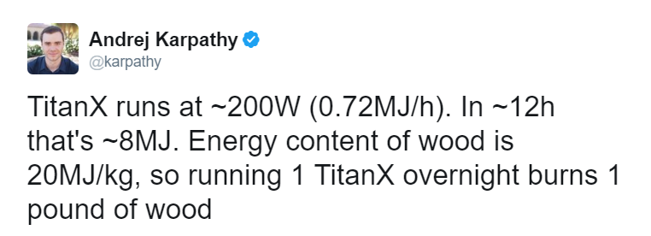
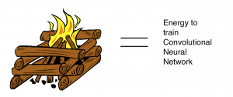
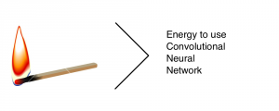
Energy to train
Convolutional
Neural Network
Energy to use
Convolutional
Neural Network
http://deeplearningkit.org/2015/12/28/deeplearningkit-deep-learning-for-ios-tested-on-iphone-6s-tvos-and-os-x-developed-in-metal-and-swift/
i

Slide 11
Base PreTrained Model
ImageNet – 1000 Object Categorizer
Inception
Resnet
i

Slide 12
Running pre-trained models on mobile
MXNet
Tensorflow
CNNDroid
DeepLearningKit
Caffe
Torch
i
Notes:
Speedups : No need to decode JPEGs, directly deal with camera image buffers

Slide 13

MXNET
Amalgamation : Pack all the code in a single source file
Pro:
Cross Platform (iOS, Android), Easy porting
Usable in any programming language
Con:
CPU only, Slow
https://github.com/Leliana/WhatsThis
i
Notes:
Very memory efficient.
MXNet can consume as little as 4 GB of memory when serving deep networks with as many as 1000 layers
Deep learning (DL) systems are complex and often have a few of dependencies. It is often painful to port a DL library into different platforms, especially for smart devices. There is one fun way to solve this problem: provide a light interface and putting all required codes into a single file with minimal dependencies.
The idea of amalgamation comes from SQLite and other projects, which pack all code into a single source file. To create the library, you only need to compile that single file. This simplifies porting to various platforms. Thanks to Jack Deng, MXNet provides an amalgamation script, that compiles all code needed for prediction based on trained DL models into a single .cc file, which has approximately 30K lines of code. The only dependency is a BLAS library.
The compiled library can be used by any other programming language.
By using amalgamation, we can easily port the prediction library to mobile devices, with nearly no dependency. Compiling on a smart platform is no longer a painful task. After compiling the library for smart platforms, the last thing is to call C-API in the target language (Java/Swift).
This does not use GPU.
It mentions about dependency on BLAS, because of which it seems it uses CPU on mobile
BLAS (Basic Linear Algebraic Subprograms) is at the heart of AI computation. Because of the sheer amount of number-crunching involved in these complex models the math routines must be optimized as much as possible. The computational firepower of GPUs make them ideal processors for AI models.
It appears that MXNet can use Atlas (libblas), OpenBLAS, and MKL. These are CPU-based libraries.
Currently the main option for running BLAS on a GPU is CuBLAS, developed specifically for NVIDIA (CUDA) GPUs. Apparently MXNet can use CuBLAS in addition to the CPU libraries.
The GPU in many mobile devices is a lower-power chip that works with ARM architectures which doesn't have a dedicated BLAS library yet.
what are my other options?
Just go with the CPU. Since it's the training that's extremely compute-intensive, using the CPU for inference isn't the show-stopper you think it is. In OpenBLAS, the routines are written in assembly and hand-optimized for each CPU it can run on. This includes ARM.
Using a C++-based framework like MXNet is probably the best choice if you are trying to go cross-platform.

Slide 14
Tensorflow
Easy pipeline to bring Tensorflow models to mobile
Great documentation
Optimizations to bring model to mobile
Upcoming : XLA (Accelerated Linear Algebra) compiler to optimize for hardware
i

Slide 15
CNNdroid
GPU accelerated CNNs for Android
Supports Caffe, Torch and Theano models
~30-40x Speedup using mobile GPU vs CPU (AlexNet)
Internally, CNNdroid expresses data parallelism for different layers, instead of leaving to the GPU’s hardware scheduler
i
Notes:
Different methods are employed in acceleration of different layers in CNNdroid. Convolution and fully connected layers, which are data-parallel and normally more compute intensive, are accelerated on the mobile GPU using RenderScript framework.
A considerable portion of these two layers can be expressed as dot products. The dot products are more efficiently calculated on SIMD units of the target mobile GPU. Therefore, we divide the computation in many vector operations and use the pre-defined dot function of the RenderScript framework. In other words, we explicitly express this level of parallelism in software, and as opposed to CUDA-based desktop libraries, do not leave it to GPU’s hardware scheduler. Comparing with convolution and fully connected layers, other layers are relatively less compute intensive and not efficient on mobile GPU. Therefore, they are accelerated on multi-core mobile CPU via multi-threading. Since ReLU layer usually appears after a convolution or fully connected layer, it is embedded into its previous layer in order to increase the performance in cases where multiple images are fed to the CNNdroid engine

Slide 16
DeepLearningKit
Platform : iOS, OS X and tvOS (Apple TV)
DNN Type : CNNs models trained in Caffe
Runs on mobile GPU, uses Metal
Pro : Fast, directly ingests Caffe models
Con : Unmaintained
i

Slide 17
Caffe
Caffe for Android https://github.com/sh1r0/caffe-android-lib
Sample app https://github.com/sh1r0/caffe-android-demo
Caffe for iOS : https://github.com/aleph7/caffe
Sample app https://github.com/noradaiko/caffe-ios-sample
Pro : Usually couple of lines to port a pretrained model to mobile CPU
Con : Unmaintained
i
Notes:
Mostly community contributions, not part of the main app

Slide 18
Running pre-trained models on mobile
Mobile Library | Platform | GPU | DNN Architecture Supported | Trained Models Supported
Tensorflow | iOS/Android | Yes | CNN,RNN,LSTM, etc | Tensorflow
CNNDroid | Android | Yes | CNN | Caffe, Torch, Theano
DeepLearningKit | iOS | Yes | CNN | Caffe
MXNet | iOS/Android | No | CNN,RNN,LSTM, etc | MXNet
Caffe | iOS/Android | No | CNN | Caffe
Torch | iOS/Android | No | CNN,RNN,LSTM, etc | Torch
i

Slide 19
Building a DL App in 1 week

Slide 20
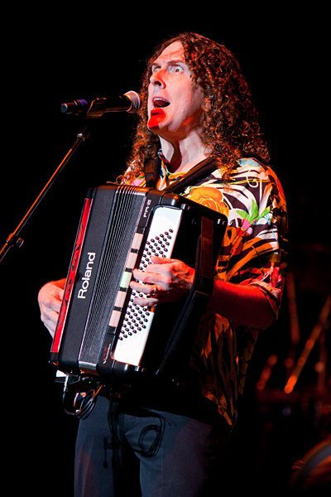
Learn Playing an Accordion
3 months
i

Slide 21
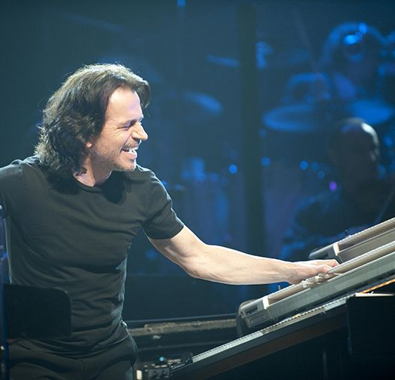
Knows Piano
Learn Playing an Accordion
3 months
1 week
Fine Tune Skills
i

Slide 22
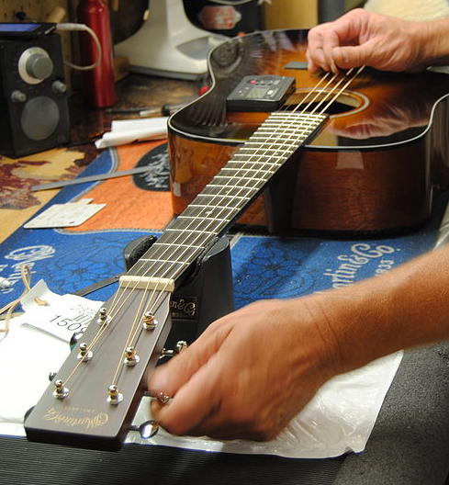
I got a dataset, Now What?
Step 1 : Find a pre-trained model
Step 2 : Fine tune a pre-trained model
Step 3 : Run using existing frameworks
“Don’t Be A Hero”
- Andrej Karpathy
i

Slide 23
How to find pretrained models for my task?
Search “Model Zoo”
Microsoft Cognitive Toolkit (previously called CNTK) – 50 Models
Caffe Model Zoo
Keras
Tensorflow
MXNet
i

Slide 24
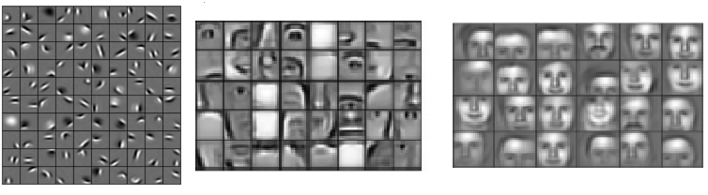
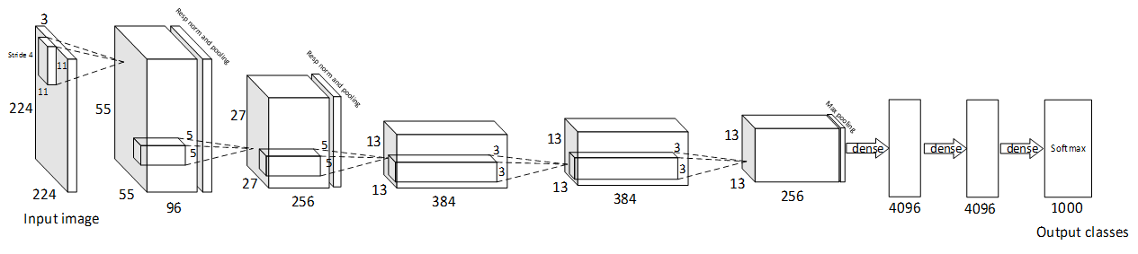
AlexNet, 2012 (simplified)
n-dimension
Feature
representation
[Krizhevsky, Sutskever,Hinton’12]
Honglak Lee, Roger Grosse, Rajesh Ranganath, and Andrew Ng, “Unsupervised Learning of Hierarchical Representations with Convolutional Deep Belief Networks”, 11
i
Notes:
Learned hierarchical features from a deep learning algorithm. Each feature can be thought of as a filter, which filters the input image for that feature (a nose). If the feature is found, the responsible units generate large activations, which can be picked up by the later classifier stages as a good indicator that the class is present.

Slide 25
Deciding how to fine tune
Size of New Dataset | Similarity to Original Dataset | What to do?
Large | High | Fine tune.
Small | High | Don’t Fine Tune, it will overfit. Train linear classifier on CNN Features
Small | Low | Train a classifier from activations in lower layers. Higher layers are dataset specific to older dataset.
Large | Low | Train CNN from scratch
http://blog.revolutionanalytics.com/2016/08/deep-learning-part-2.html
i
Notes:
In practice, we don’t usually train an entire DCNN from scratch with random initialization. This is because it is relatively rare to have a dataset of sufficient size that is required for the depth of network required. Instead, it is common to pre-train a DCNN on a very large dataset and then use the trained DCNN weights either as an initialization or a fixed feature extractor for the task of interest.
Fine-Tuning: Transfer learning strategies depend on various factors, but the two most important ones are the size of the new dataset, and its similarity to the original dataset. Keeping in mind that DCNN features are more generic in early layers and more dataset-specific in later layers, there are four major scenarios:
New dataset is smaller in size and similar in content compared to original dataset: If the data is small, it is not a good idea to fine-tune the DCNN due to overfitting concerns. Since the data is similar to the original data, we expect higher-level features in the DCNN to be relevant to this dataset as well. Hence, the best idea might be to train a linear classifier on the CNN-features.
New dataset is relatively large in size and similar in content compared to the original dataset: Since we have more data, we can have more confidence that we would not over fit if we were to try to fine-tune through the full network.
New dataset is smaller in size but very different in content compared to the original dataset: Since the data is small, it is likely best to only train a linear classifier. Since the dataset is very different, it might not be best to train the classifier from the top of the network, which contains more dataset-specific features. Instead, it might work better to train a classifier from activations somewhere earlier in the network.
New dataset is relatively large in size and very different in content compared to the original dataset: Since the dataset is very large, we may expect that we can afford to train a DCNN from scratch. However, in practice it is very often still beneficial to initialize with weights from a pre-trained model. In this case, we would have enough data and confidence to fine-tune through the entire network.

Slide 26
Deciding when to fine tune
Size of New Dataset | Similarity to Original Dataset | What to do?
Large | High | Fine tune.
Small | High | Don’t Fine Tune, it will overfit. Train linear classifier on CNN Features
Small | Low | Train a classifier from activations in lower layers. Higher layers are dataset specific to older dataset.
Large | Low | Train CNN from scratch
http://blog.revolutionanalytics.com/2016/08/deep-learning-part-2.html
i
Notes:
In practice, we don’t usually train an entire DCNN from scratch with random initialization. This is because it is relatively rare to have a dataset of sufficient size that is required for the depth of network required. Instead, it is common to pre-train a DCNN on a very large dataset and then use the trained DCNN weights either as an initialization or a fixed feature extractor for the task of interest.
Fine-Tuning: Transfer learning strategies depend on various factors, but the two most important ones are the size of the new dataset, and its similarity to the original dataset. Keeping in mind that DCNN features are more generic in early layers and more dataset-specific in later layers, there are four major scenarios:
New dataset is smaller in size and similar in content compared to original dataset: If the data is small, it is not a good idea to fine-tune the DCNN due to overfitting concerns. Since the data is similar to the original data, we expect higher-level features in the DCNN to be relevant to this dataset as well. Hence, the best idea might be to train a linear classifier on the CNN-features.
New dataset is relatively large in size and similar in content compared to the original dataset: Since we have more data, we can have more confidence that we would not over fit if we were to try to fine-tune through the full network.
New dataset is smaller in size but very different in content compared to the original dataset: Since the data is small, it is likely best to only train a linear classifier. Since the dataset is very different, it might not be best to train the classifier from the top of the network, which contains more dataset-specific features. Instead, it might work better to train a classifier from activations somewhere earlier in the network.
New dataset is relatively large in size and very different in content compared to the original dataset: Since the dataset is very large, we may expect that we can afford to train a DCNN from scratch. However, in practice it is very often still beneficial to initialize with weights from a pre-trained model. In this case, we would have enough data and confidence to fine-tune through the entire network.

Slide 27
Deciding when to fine tune
Size of New Dataset | Similarity to Original Dataset | What to do?
Large | High | Fine tune.
Small | High | Don’t Fine Tune, it will overfit. Train linear classifier on CNN Features
Small | Low | Train a classifier from activations in lower layers. Higher layers are dataset specific to older dataset.
Large | Low | Train CNN from scratch
http://blog.revolutionanalytics.com/2016/08/deep-learning-part-2.html
i
Notes:
In practice, we don’t usually train an entire DCNN from scratch with random initialization. This is because it is relatively rare to have a dataset of sufficient size that is required for the depth of network required. Instead, it is common to pre-train a DCNN on a very large dataset and then use the trained DCNN weights either as an initialization or a fixed feature extractor for the task of interest.
Fine-Tuning: Transfer learning strategies depend on various factors, but the two most important ones are the size of the new dataset, and its similarity to the original dataset. Keeping in mind that DCNN features are more generic in early layers and more dataset-specific in later layers, there are four major scenarios:
New dataset is smaller in size and similar in content compared to original dataset: If the data is small, it is not a good idea to fine-tune the DCNN due to overfitting concerns. Since the data is similar to the original data, we expect higher-level features in the DCNN to be relevant to this dataset as well. Hence, the best idea might be to train a linear classifier on the CNN-features.
New dataset is relatively large in size and similar in content compared to the original dataset: Since we have more data, we can have more confidence that we would not over fit if we were to try to fine-tune through the full network.
New dataset is smaller in size but very different in content compared to the original dataset: Since the data is small, it is likely best to only train a linear classifier. Since the dataset is very different, it might not be best to train the classifier from the top of the network, which contains more dataset-specific features. Instead, it might work better to train a classifier from activations somewhere earlier in the network.
New dataset is relatively large in size and very different in content compared to the original dataset: Since the dataset is very large, we may expect that we can afford to train a DCNN from scratch. However, in practice it is very often still beneficial to initialize with weights from a pre-trained model. In this case, we would have enough data and confidence to fine-tune through the entire network.

Slide 28
Deciding when to fine tune
Size of New Dataset | Similarity to Original Dataset | What to do?
Large | High | Fine tune.
Small | High | Don’t Fine Tune, it will overfit. Train linear classifier on CNN Features
Small | Low | Train a classifier from activations in lower layers. Higher layers are dataset specific to older dataset.
Large | Low | Train CNN from scratch
http://blog.revolutionanalytics.com/2016/08/deep-learning-part-2.html
i
Notes:
In practice, we don’t usually train an entire DCNN from scratch with random initialization. This is because it is relatively rare to have a dataset of sufficient size that is required for the depth of network required. Instead, it is common to pre-train a DCNN on a very large dataset and then use the trained DCNN weights either as an initialization or a fixed feature extractor for the task of interest.
Fine-Tuning: Transfer learning strategies depend on various factors, but the two most important ones are the size of the new dataset, and its similarity to the original dataset. Keeping in mind that DCNN features are more generic in early layers and more dataset-specific in later layers, there are four major scenarios:
New dataset is smaller in size and similar in content compared to original dataset: If the data is small, it is not a good idea to fine-tune the DCNN due to overfitting concerns. Since the data is similar to the original data, we expect higher-level features in the DCNN to be relevant to this dataset as well. Hence, the best idea might be to train a linear classifier on the CNN-features.
New dataset is relatively large in size and similar in content compared to the original dataset: Since we have more data, we can have more confidence that we would not over fit if we were to try to fine-tune through the full network.
New dataset is smaller in size but very different in content compared to the original dataset: Since the data is small, it is likely best to only train a linear classifier. Since the dataset is very different, it might not be best to train the classifier from the top of the network, which contains more dataset-specific features. Instead, it might work better to train a classifier from activations somewhere earlier in the network.
New dataset is relatively large in size and very different in content compared to the original dataset: Since the dataset is very large, we may expect that we can afford to train a DCNN from scratch. However, in practice it is very often still beneficial to initialize with weights from a pre-trained model. In this case, we would have enough data and confidence to fine-tune through the entire network.

Slide 29
Building a DL Website in 1 week

Slide 30
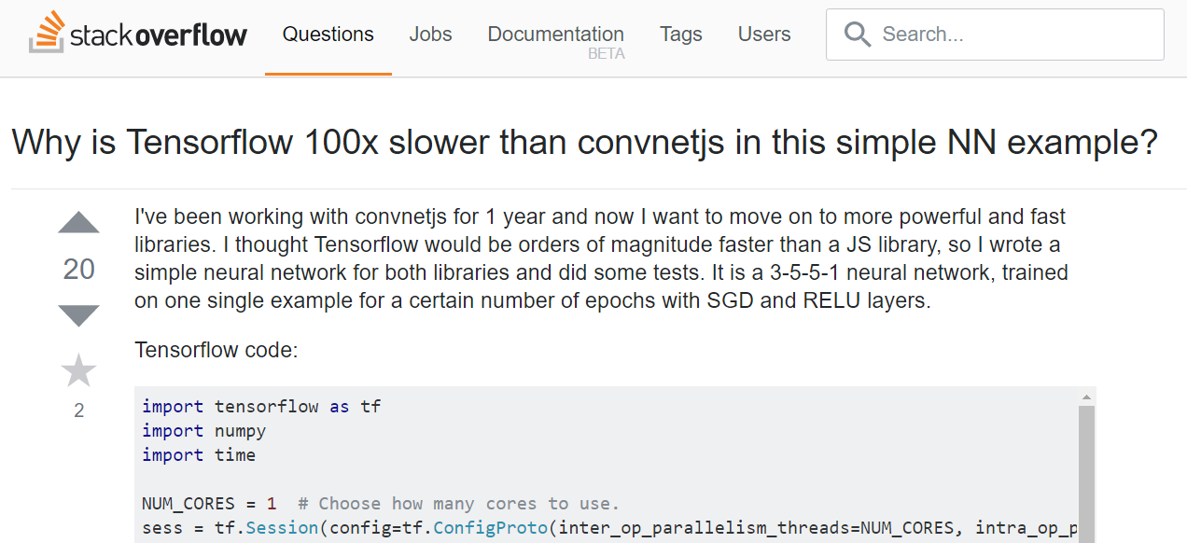
Less Data + Smaller Networks = Faster browser training
i
Notes:
The data input is so small that most of the time is spent in just conversion between python and the C++ core, while the JS is just one language.
You are using only one core in Tensorflow while the JS could potentially leverage more than one the JS library is able to create a highly optimized JIT version of the program.

Slide 31
Several JavaScript Libraries
Run large CNNs
Keras-JS
MXNetJS
CaffeJS
Train and Run CNNs
ConvNetJS
Train and Run LSTMs
Brain.js
Synaptic.js
Train and Run NNs
Mind.js
DN2A
i
Notes:
Synaptic and Mind are often used for running on node.js servers
The node.js ones are often used for training continuous data from Accelerometers, Sales forecast

Slide 32
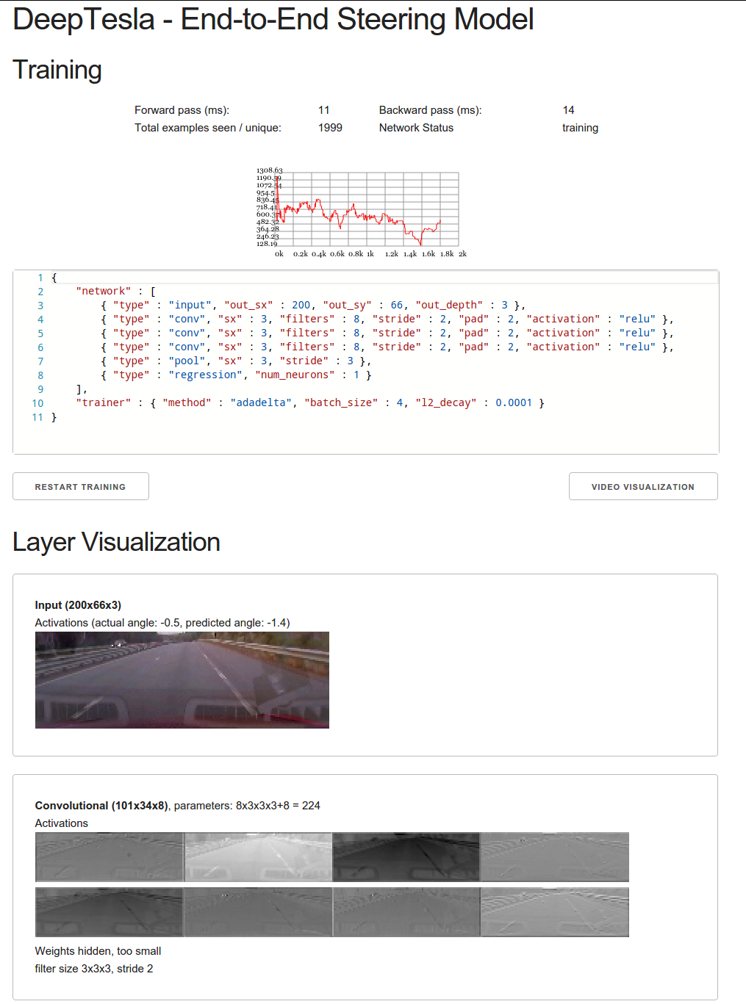
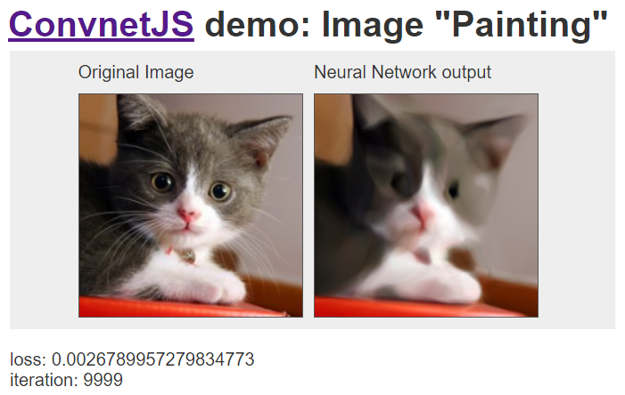
ConvNetJS
Both Train and Test NNs in browser
Train CNNs in browser
i
Notes:
Original Boss
This demo that treats the pixels of an image as a learning problem: it takes the (x,y) position on a grid and learns to predict the color at that point using regression to (r,g,b). It's a bit like compression, since the image information is encoded in the weights of the network, but almost certainly not of practical kind

Slide 33
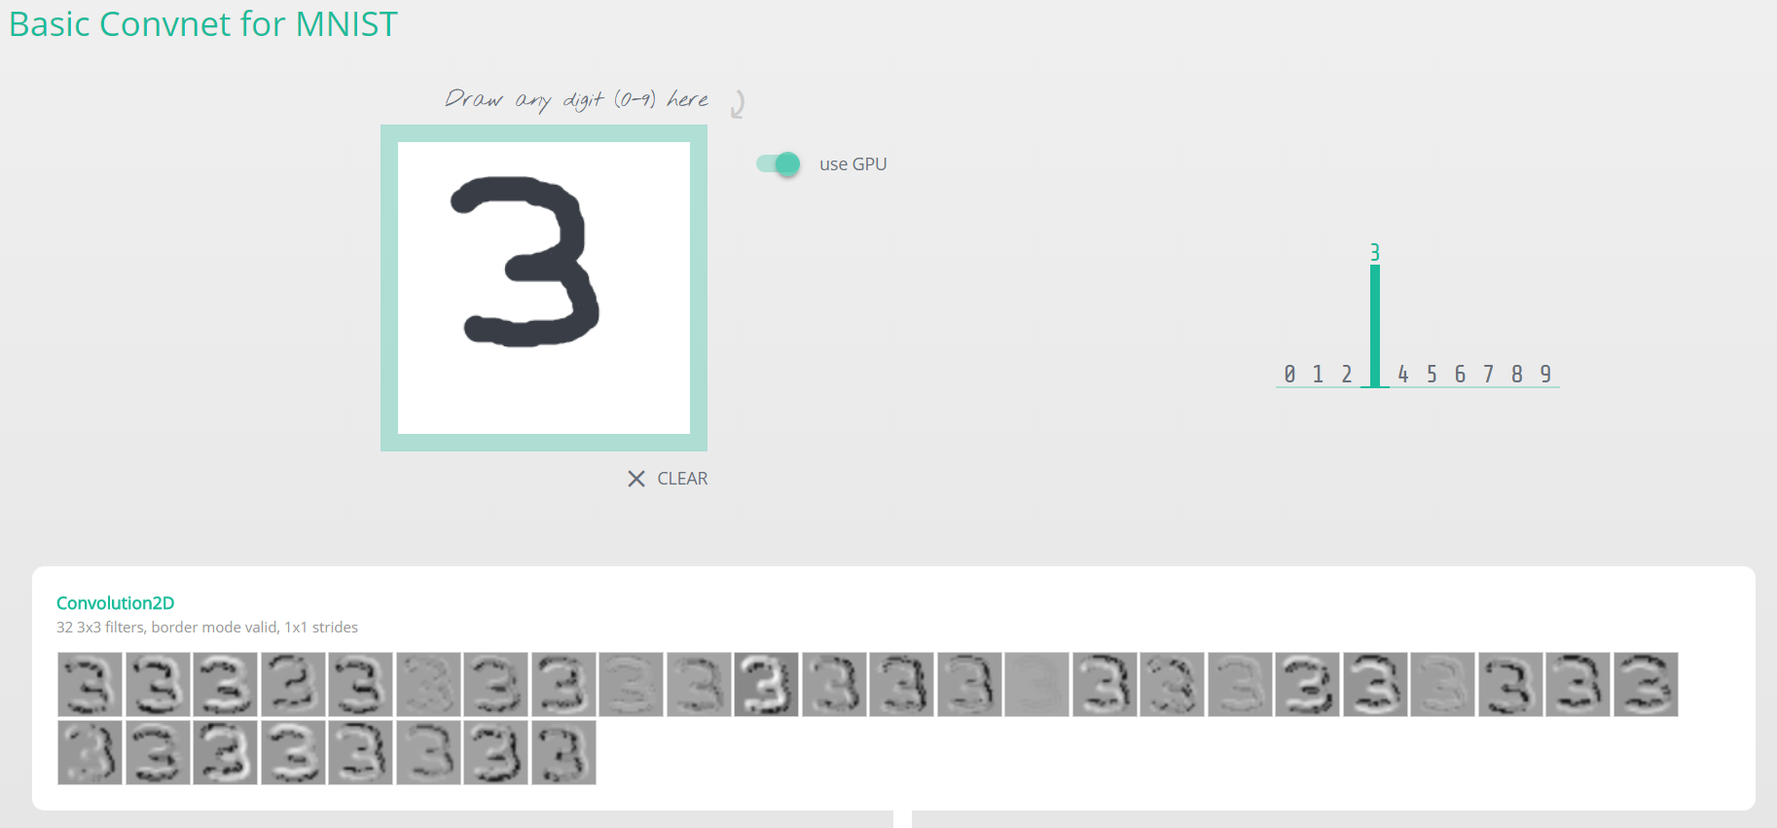
Keras.js
Run Keras models in browser, with GPU support.
i
Notes:
You can load 50 Layer Resnet, Inception V3, Bidirectional LSTM

Slide 34
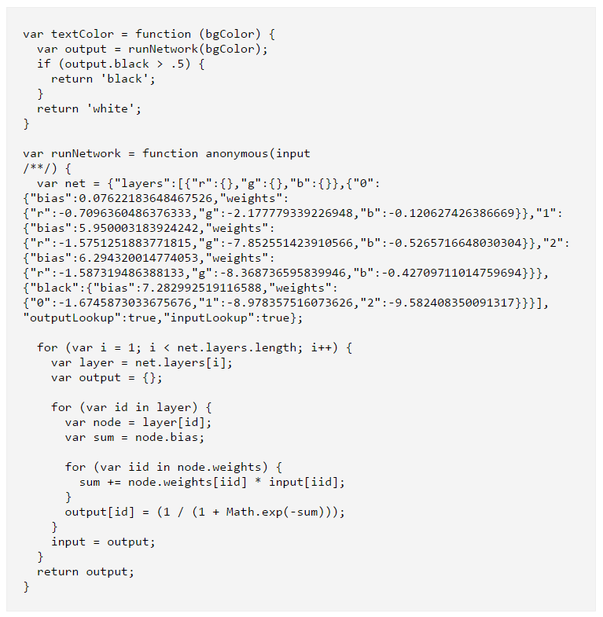
Brain.JS
Trained NN to recognize color contrast
Train and run NNs in browser
Supports Feedforward, RNN, LSTM, GRU
No CNNs
Demo : http://brainjs.com/
i

Slide 35
MXNetJS
On Firefox and Microsoft Edge, performance is 8x faster than Chrome.
Optimization difference because of ASM.js.
i
Notes:
On Microsoft Edge and Firefox, performance is at least 8 times better than Google Chrome. We assume it is optimization difference on ASM.js.

Slide 36
Building a DL App in 1 month
(and get featured in Apple App store)

Slide 37
Response Time Limits – Powers of 10
0.1 second : Reacting instantly
1.0 seconds : User’s flow of thought
10 seconds : Keeping the user’s attention
[Miller 1968; Card et al. 1991; Jakob Nielsen 1993]:
i
Notes:
[Miller 1968; Card et al. 1991]:
0.1 second is about the limit for having the user feel that the system is reacting instantaneously, meaning that no special feedback is necessary except to display the result.
1.0 second is about the limit for the user's flow of thought to stay uninterrupted, even though the user will notice the delay. Normally, no special feedback is necessary during delays of more than 0.1 but less than 1.0 second, but the user does lose the feeling of operating directly on the data.
10 seconds is about the limit for keeping the user's attention focused on the dialogue. For longer delays, users will want to perform other tasks while waiting for the computer to finish, so they should be given feedback indicating when the computer expects to be done. Feedback during the delay is especially important if the response time is likely to be highly variable, since users will then not know what to expect.

Slide 38
Apple frameworks for Deep Learning Inference
BNNS – Basic Neural Network Subroutine
MPS – Metal Performance Shaders
i
Notes:
Apple’s deep learning frameworks are tuned for just one single purpose: pushing data as quickly as possible through the network’s layers.
You’ll have to replicate the network design by hand in code, by painstakingly creating the layers and configuring them. It’s easy to make mistakes.
Swift also does not have a native 16-bit floating point type but both BNNS and MPSCNN are at their most speedy with such half-precision floats. You will have to use Accelerate framework routines to convert between regular and half floats.
Be ready some low-level bit hacking with both of these APIs

Slide 39
Metal Performance Shaders (MPS)
Fast, Provides GPU acceleration for inference phase
Faster app load times than Tensorflow (Jan 2017)
About 1/3rd the run time memory of Tensorflow on Inception-V3 (Jan 2017)
~130 ms on iPhone 7S Plus to run Inception-V3
Cons:
Limited documentation.
No easy way to programmatically port models.
No batch normalization. Solution : Join Conv and BatchNorm weights
i
Notes:
we use float16s for storage and computation as the AX GPUs have 16-bit ALUs. Metal will convert our weights and biases from 32-bit floats automatically.

Slide 40
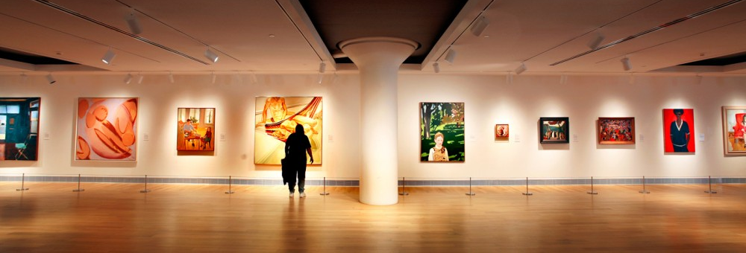
Putting out more frames than an art gallery
i

Slide 41
Basic Neural Network Subroutines (BNNS)
Runs on CPU
BNNS is faster for smaller networks than MPS but slower for bigger networks
i
Notes:
Apple’s deep learning frameworks are tuned for just one single purpose: pushing data as quickly as possible through the network’s layers.
You’ll have to replicate the network design by hand in code, by painstakingly creating the layers and configuring them. It’s easy to make mistakes.
Swift also does not have a native 16-bit floating point type but both BNNS and MPSCNN are at their most speedy with such half-precision floats. You will have to use Accelerate framework routines to convert between regular and half floats.
Be ready some low-level bit hacking with both of these APIs

Slide 42
BrainCore
NN Framework for iOS
Provides LSTMs functionality
Fast, uses Metal, runs on iPhone GPU
https://github.com/aleph7/braincore
i
Notes:
Well maintained

Slide 43
Building a DL App in 6 months

Slide 44
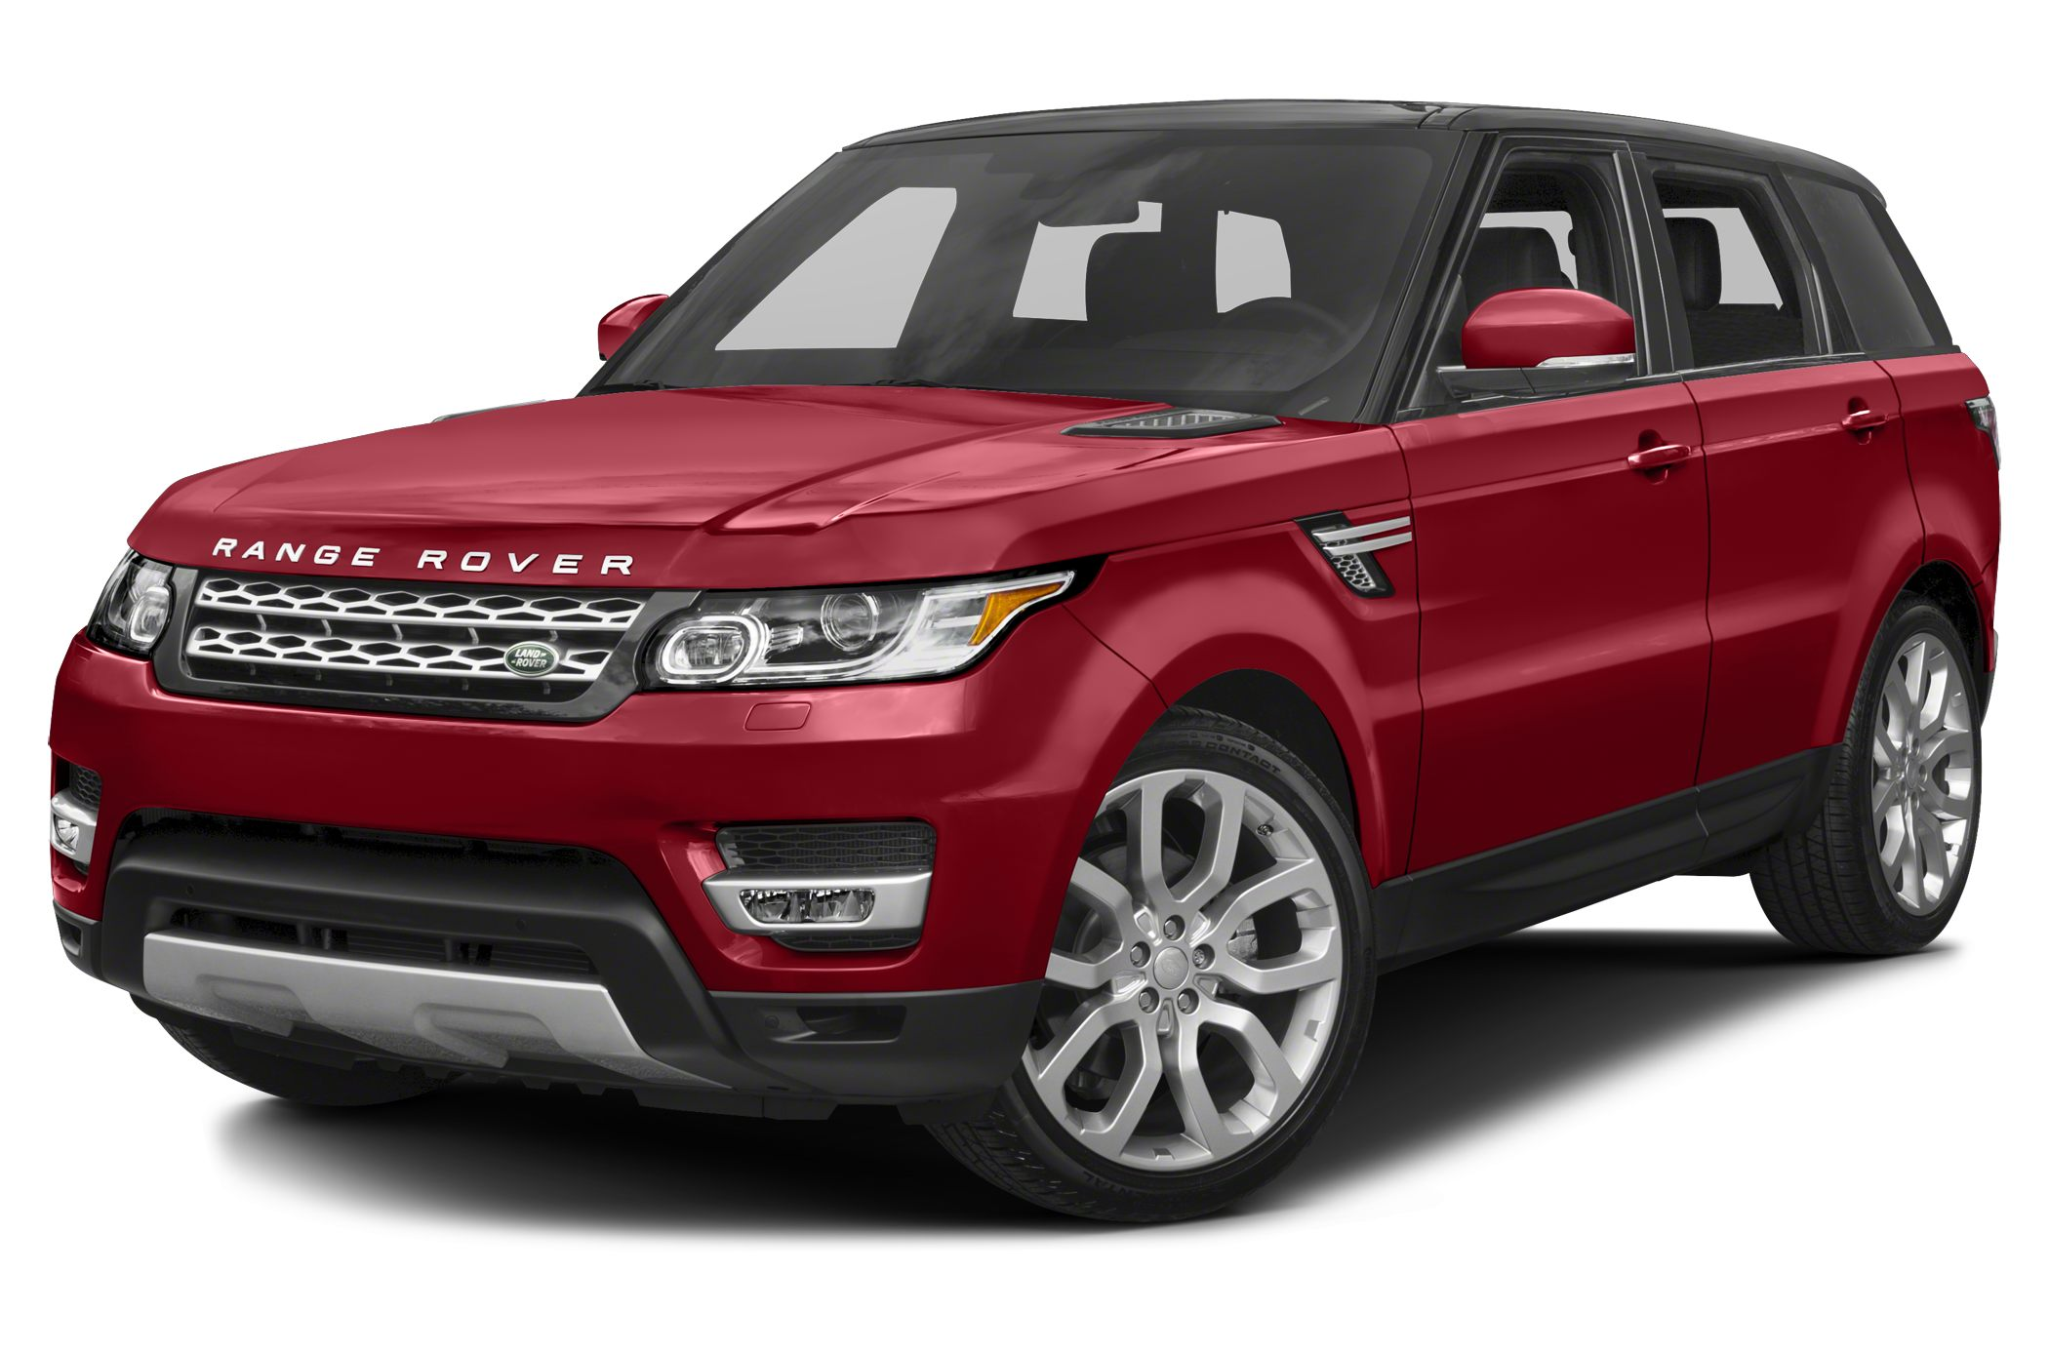
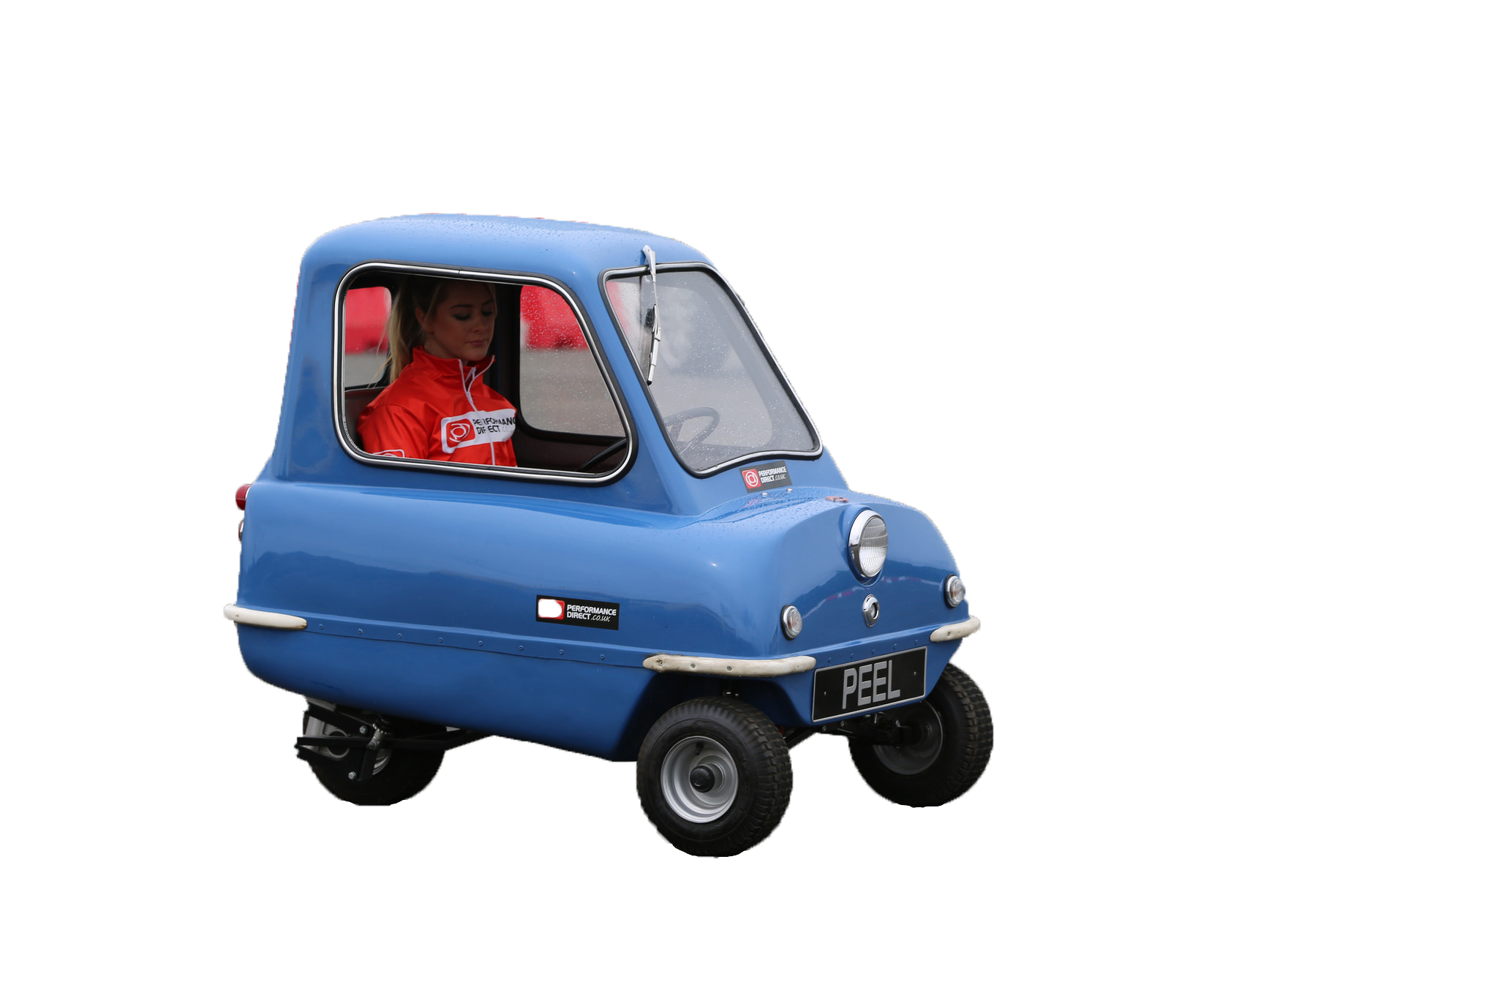
What you want
What you can afford
$200,000
$2000
https://www.flickr.com/photos/kenjonbro/9075514760/ and http://www.newcars.com/land-rover/range-rover-sport/2016
i
Notes:
As we all have painfully experienced, in real life, what you really want, is not what you can always afford.
And that's the same in machine learning,
We all know deep learning works if you have large GPU servers, what about when you want to run it on a tiny little device.
What's the number 1 limitation, it turns out to be memory.
If you look at image net in the last couple of years, it started with 240 megabytes. VGG was over half a gig.
So the question we will solve now is how to get these neural networks do these amazing things yet have a very small memory footprint

Slide 45
Revolution of Depth
AlexNet, 8 layers
(ILSVRC 2012)
Kaiming He, Xiangyu Zhang, Shaoqing Ren, & Jian Sun. “Deep Residual Learning for Image Recognition”, 2015
i

Slide 46
Revolution of Depth
AlexNet, 8 layers
(ILSVRC 2012)
VGG, 19 layers
(ILSVRC 2014)
GoogleNet, 22 layers
(ILSVRC 2014)
Kaiming He, Xiangyu Zhang, Shaoqing Ren, & Jian Sun. “Deep Residual Learning for Image Recognition”, 2015
i
Notes:
Pause after showing this.

Slide 47

Revolution of Depth
AlexNet, 8 layers
(ILSVRC 2012)
VGG, 19 layers
(ILSVRC 2014)
ResNet, 152 layers
(ILSVRC 2015)
Ultra deep
Kaiming He, Xiangyu Zhang, Shaoqing Ren, & Jian Sun. “Deep Residual Learning for Image Recognition”, 2015
i
Notes:
Just more layers, nothing special

Slide 48
Revolution of Depth
ResNet, 152 layers
Kaiming He, Xiangyu Zhang, Shaoqing Ren, & Jian Sun. “Deep Residual Learning for Image Recognition”, 2015
i
Notes:
Here is another view of this model.
This is the equivalent of Big data for powerpoint

Slide 49
Revolution of Depth
152 layers
22 layers
19 layers
8 layers
8 layers
shallow
Kaiming He, Xiangyu Zhang, Shaoqing Ren, & Jian Sun. “Deep Residual Learning for Image Recognition”, 2015
i
Notes:
Errors are reducing by 40% year on year
Previously, they used to reduce by 5% year by year

Slide 50
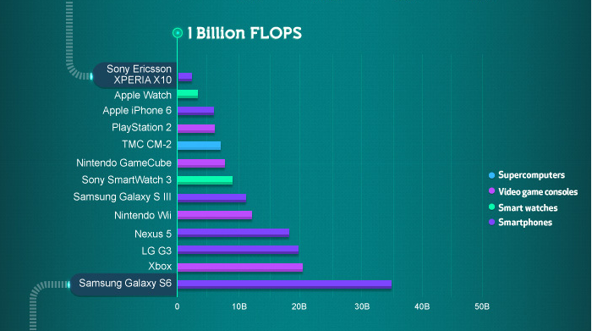
Your Budget - Smartphone Floating Point Operations Per Second (2015)
http://pages.experts-exchange.com/processing-power-compared/
i

Slide 51
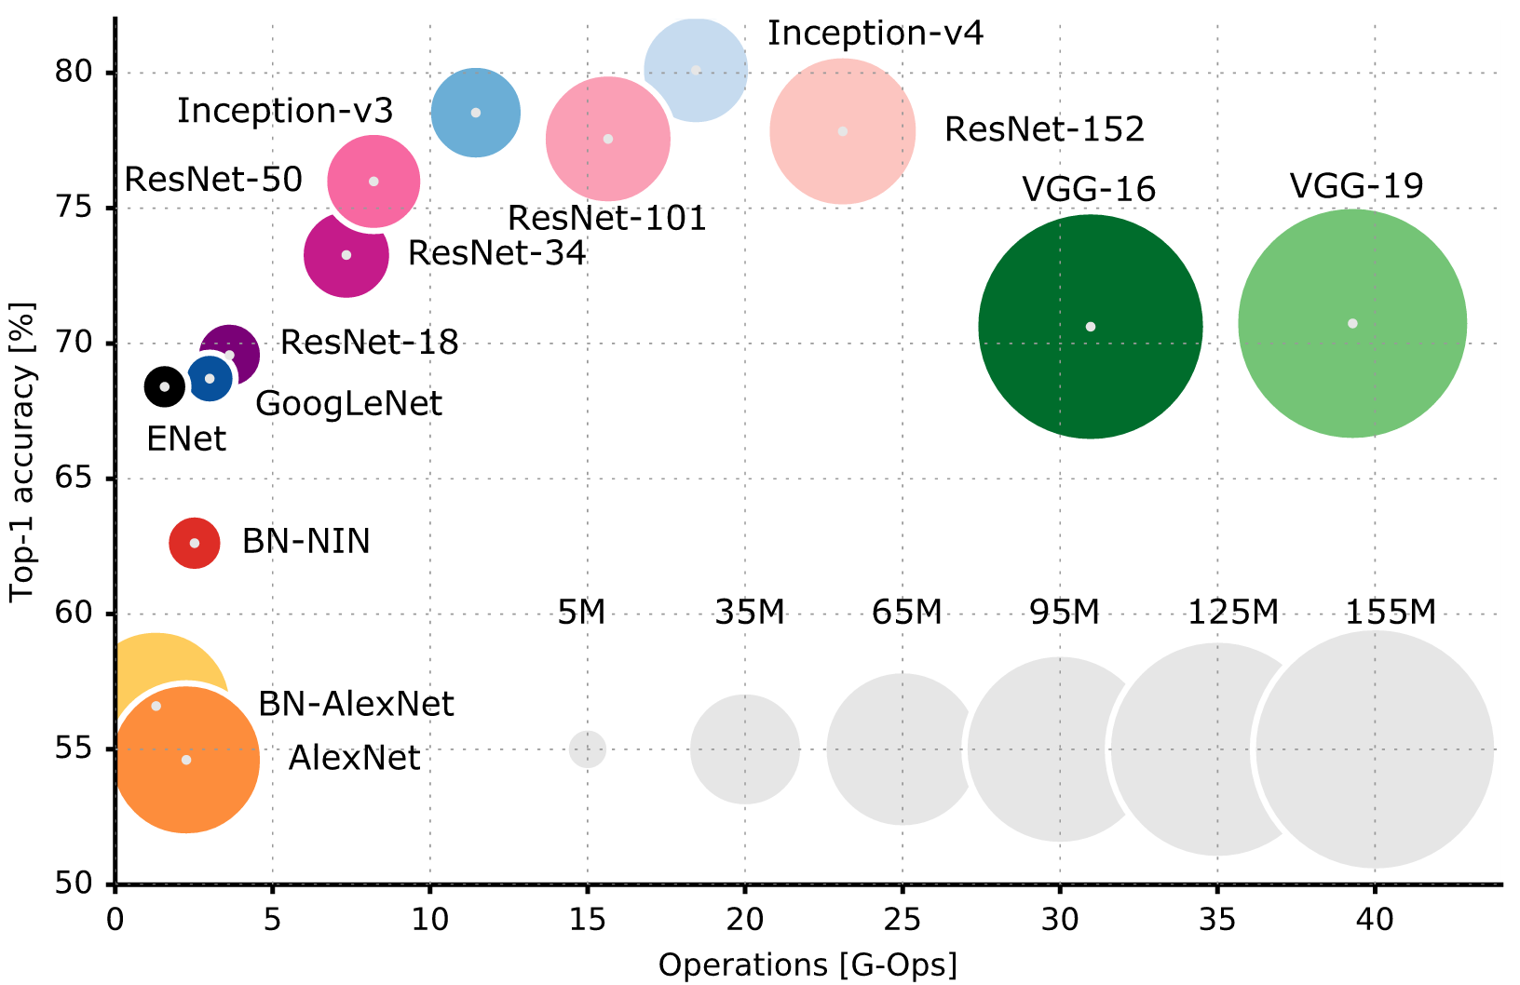
Accuracy vs Operations Per Image Inference
What we want
552 MB
Size is proportional to num parameters
240 MB
Alfredo Canziani, Adam Paszke, Eugenio Culurciello, “An Analysis of Deep Neural Network Models for Practical Applications” 2016
i
Notes:
Compromise between accuracy, number of parameters,

Slide 52
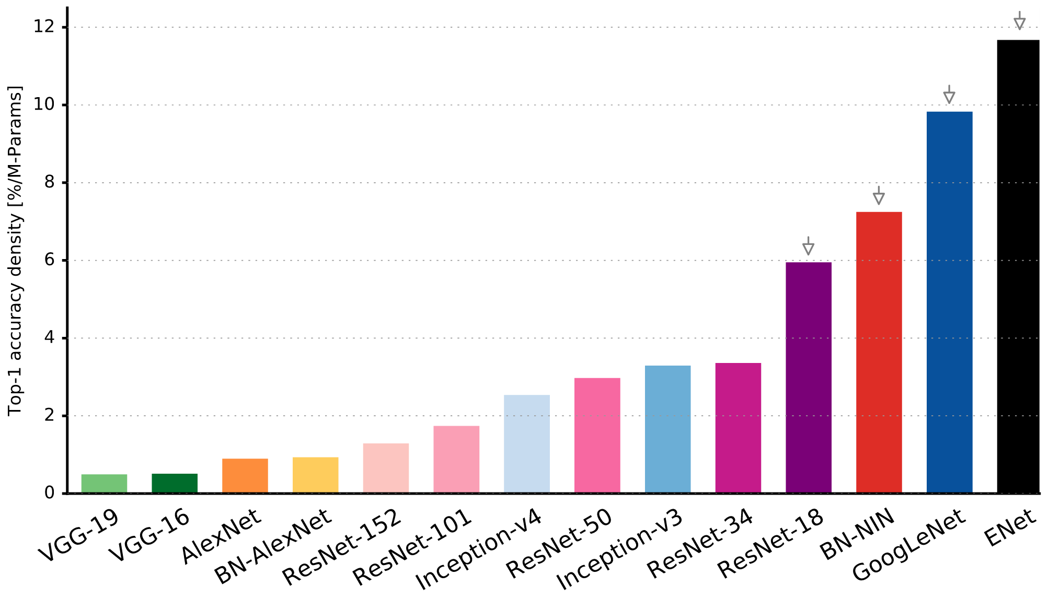
Accuracy Per Parameter
Alfredo Canziani, Adam Paszke, Eugenio Culurciello, “An Analysis of Deep Neural Network Models for Practical Applications” 2016
i

Slide 53
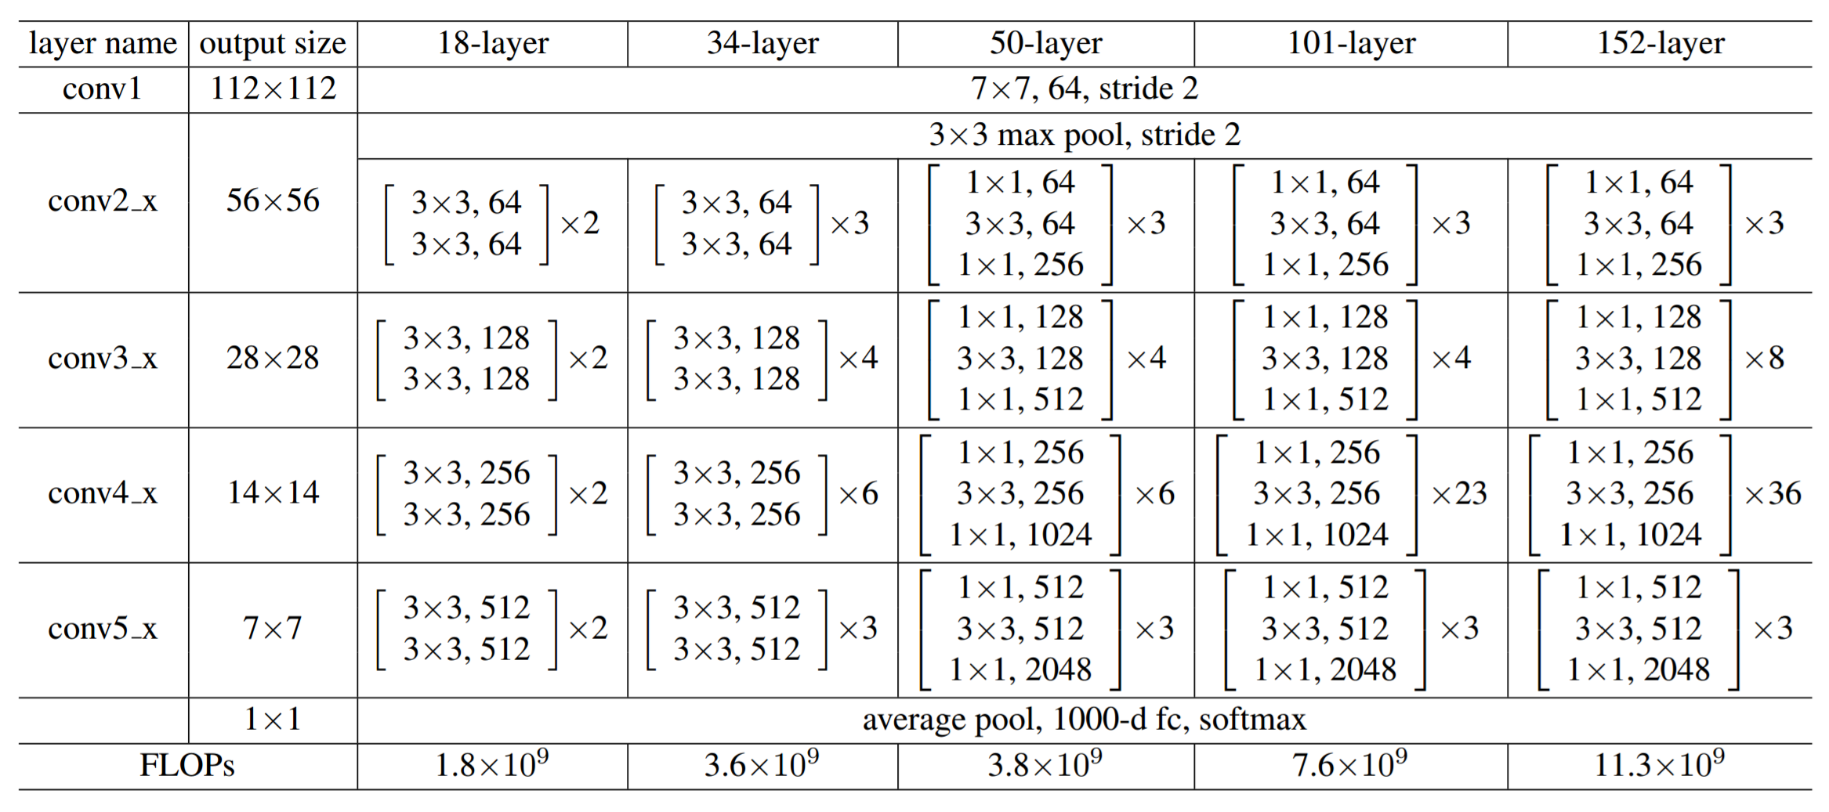
Pick your DNN Architecture for your mobile architecture
Resnet Family
Under 150 ms on iPhone 7 using Metal GPU
Kaiming He, Xiangyu Zhang, Shaoqing Ren, Jian Sun, "Deep Residual Learning for Image Recognition”, 2015
i

Slide 54
Strategies to make DNNs even more efficient
Shallow networks
Compressing pre-trained networks
Designing compact layers
Quantizing parameters
Network binarization
i
Notes:
DNNs often suffer from over-parameterization and large amount of redundancy in their models. This typically results in inefficient computation and memory usage

Slide 55
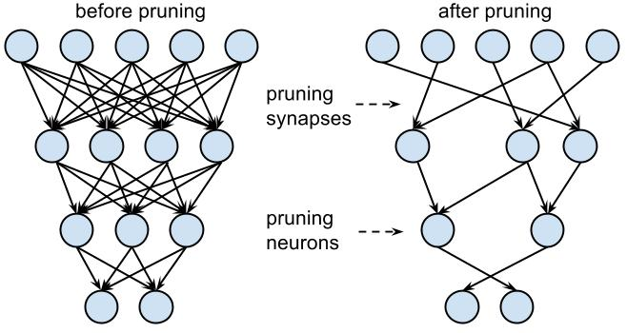
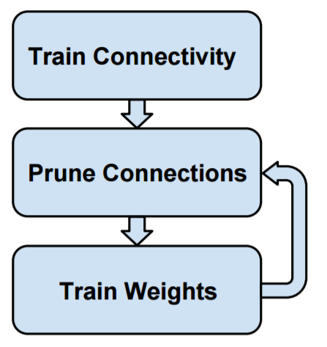
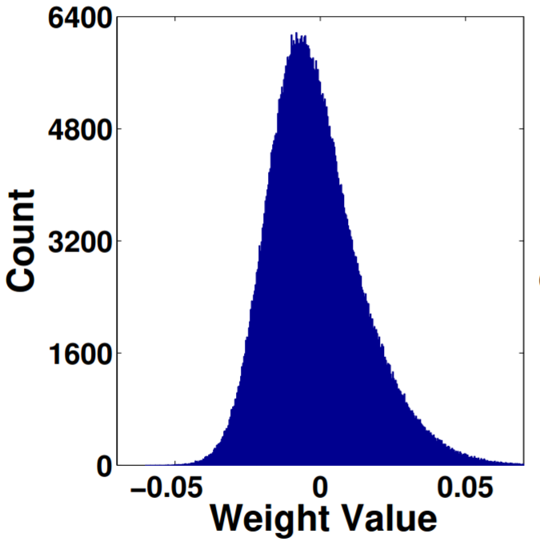
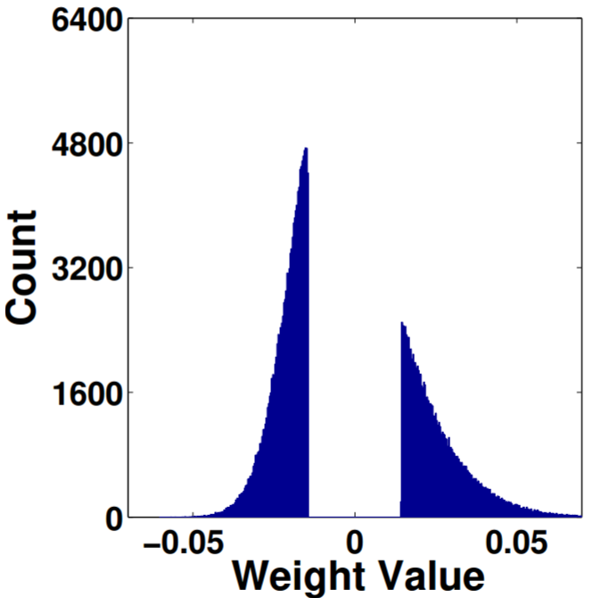
Pruning
Aim : Remove all connections with absolute weights below a threshold
Song Han, Jeff Pool, John Tran, William J. Dally, "Learning both Weights and Connections for Efficient Neural Networks", 2015
i
Notes:
Pruning redundant, non-informative weights in a previously trained network reduces the size of the network at inference time.
Take a network, prune, and then retrain the remaining connections

Slide 56
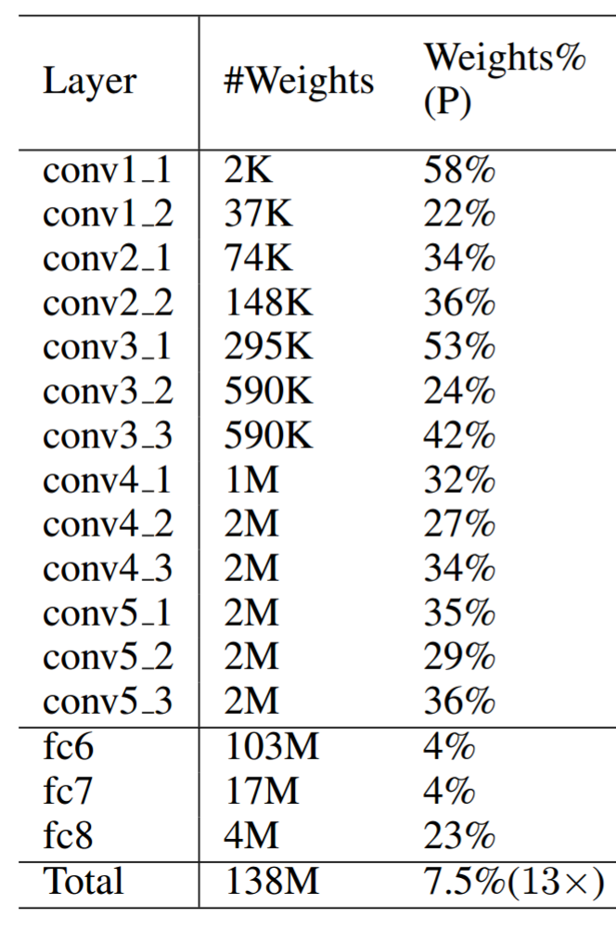
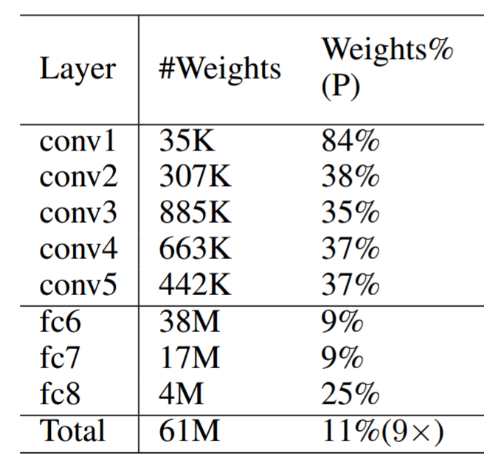
Observation : Most parameters in Fully Connected Layers
96% of all parameters
90% of all parameters
AlexNet 240 MB
VGG-16 552 MB
i
Notes:
VGG-16 contains 90% of the weights
AlexNet contains 96% of the weights
Most computation happen in convolutional layers

Slide 57
Pruning gets quickest model compression without accuracy loss
First layer which directly interacts with image is sensitive and cannot be pruned too much without hurting accuracy
AlexNet 240 MB
VGG-16 552 MB
i
Notes:
VGG-16 contains 90% of the weights
AlexNet contains 96% of the weights
Resnet, GoogleNet, Inception have majority convolutional layers, so they compress less

Slide 58
Weight Sharing
Idea : Cluster weights with similar values together, and store in a dictionary.
Codebook
Huffman coding
HashedNets
Simplest implementation:
Round all weights into 256 levels
Tensorflow export script reduces inception zip file from 87 MB to 26 MB with 1% drop in precision
i

Slide 59
Selective training to keep networks shallow
Idea : Augment data limited to how your network will be used
Example : If making a selfie app, no benefit in rotating training images beyond +-45 degrees. Your phone will anyway rotate.
Followed by WordLens / Google Translate
Example : Add blur if analyzing mobile phone frames
i

Slide 60

Design consideration for custom architectures – Small Filters
Replace large 5x5, 7x7 convolutions with stacks of 3x3 convolutions
Replace NxN convolutions with stack of 1xN and Nx1
Fewer parameters ☺
Less compute ☺
More non-linearity ☺
Three layers of 3x3 convolutions >>
One layer of 7x7 convolution
Better
Faster
Stronger
Andrej Karpathy, CS-231n Notes, Lecture 11
i
Notes:
1x1 bottleneck convolutions are very efficient

Slide 61
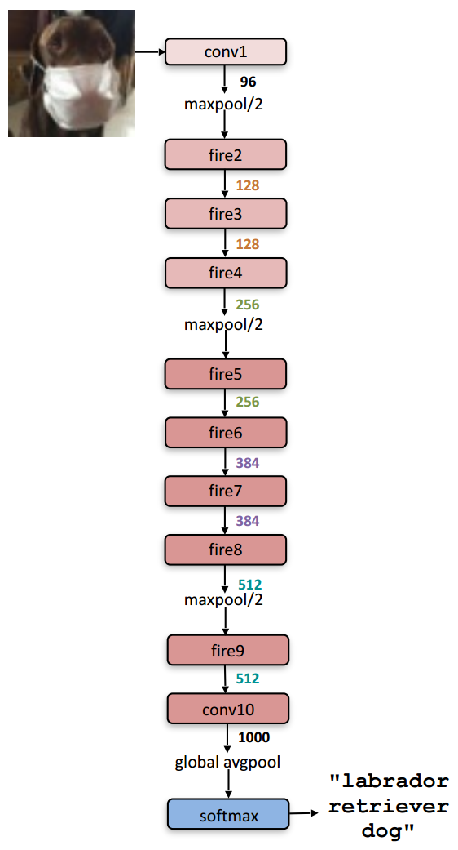
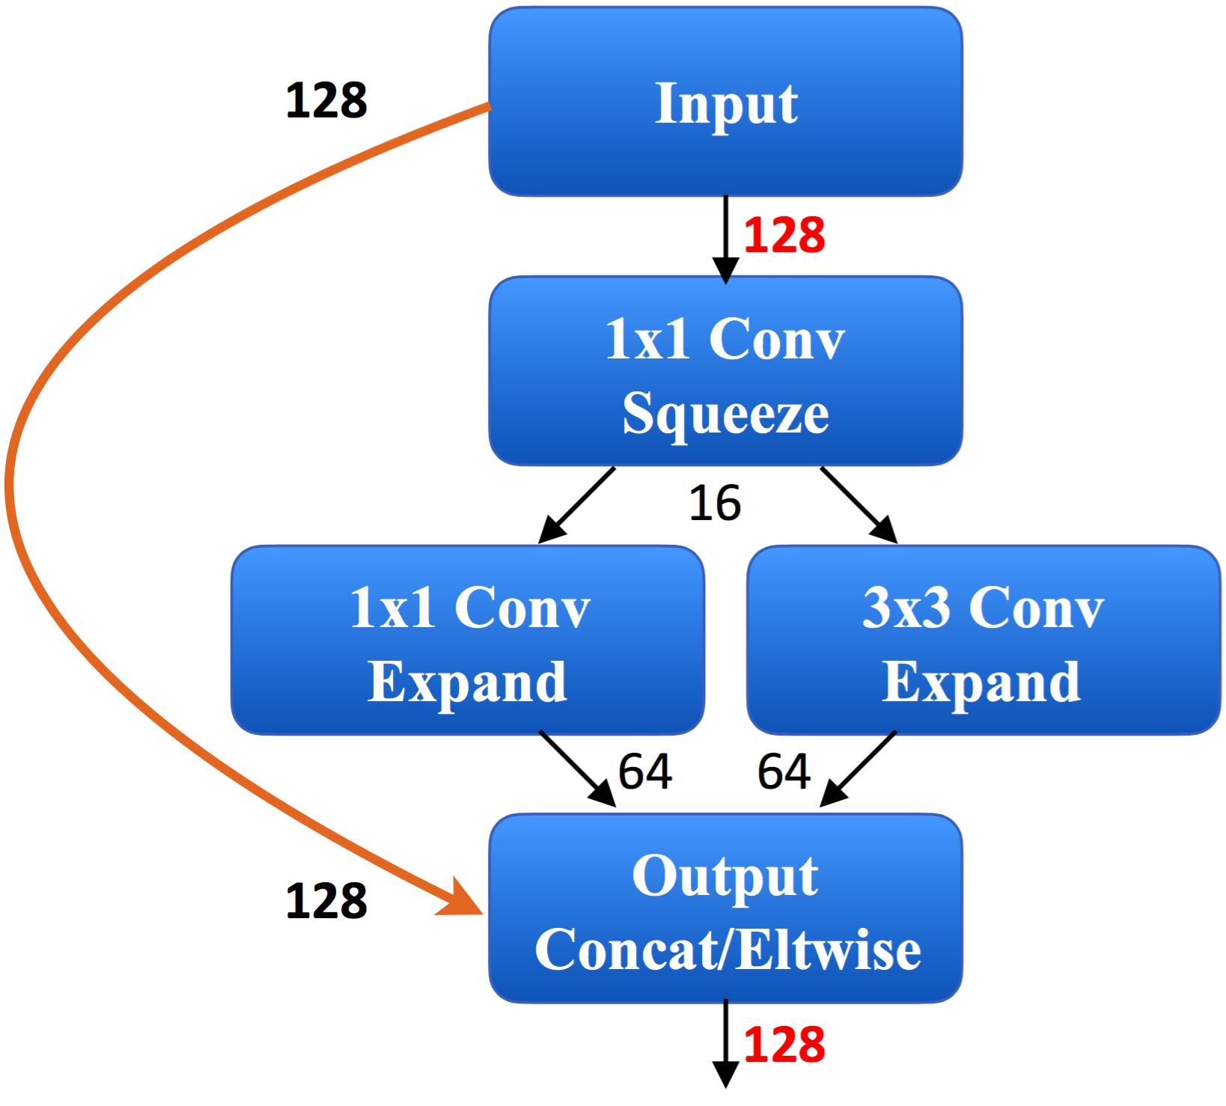
SqueezeNet - AlexNet-level accuracy in 0.5 MB
Fire Block
SqueezeNet base 4.8 MB
SqueezeNet compressed 0.5 MB
80.3% top-5 Accuracy on ImageNet
0.72 GFLOPS/image
Forrest N. Iandola, Song Han et al, "SqueezeNet: AlexNet-level accuracy with 50x fewer parameters and <0.5MB model size"
i
Notes:
SqueezeNet has been recently released. It is a re-hash of many concepts from ResNet and Inception, and show that after all, a better design of architecture will deliver small network sizes and parameters without needing complex compression algorithms.
Strategy 1. Replace 3x3 filters with 1x1 filters
Strategy 2. Decrease the number of input channels to 3x3 filters
Strategy 3. Downsample late in the network so that convolution layers have large activation maps.

Slide 62
Reduced precision
Reduce precision from 32 bits to <=16 bits or lesser
Use stochastic rounding for best results
In Practice:
Ristretto + Caffe
Automatic Network quantization
Finds balance between compression rate and accuracy
Apple Metal Performance Shaders automatically quantize to 16 bits
Tensorflow has 8 bit quantization support
Gemmlowp – Low precision matrix multiplication library
i
Notes:
Ristretto is an automated CNN-approximation tool which condenses 32-bit floating point networks. Ristretto is an extension of Caffe and allows to test, train and fine-tune networks with limited numerical precision.
Ristretto In a Minute
Ristretto Tool: The Ristretto tool performs automatic network quantization and scoring, using different bit-widths for number representation, to find a good balance between compression rate and network accuracy.
Ristretto Layers: Ristretto re-implements Caffe-layers and simulates reduced word width arithmetic.
Testing and Training: Thanks to Ristretto’s smooth integration into Caffe, network description files can be changed to quantize different layers. The bit-width used for different layers as well as other parameters can be set in the network’s prototxt file. This allows to directly test and train condensed networks, without any need of recompilation.

Slide 63
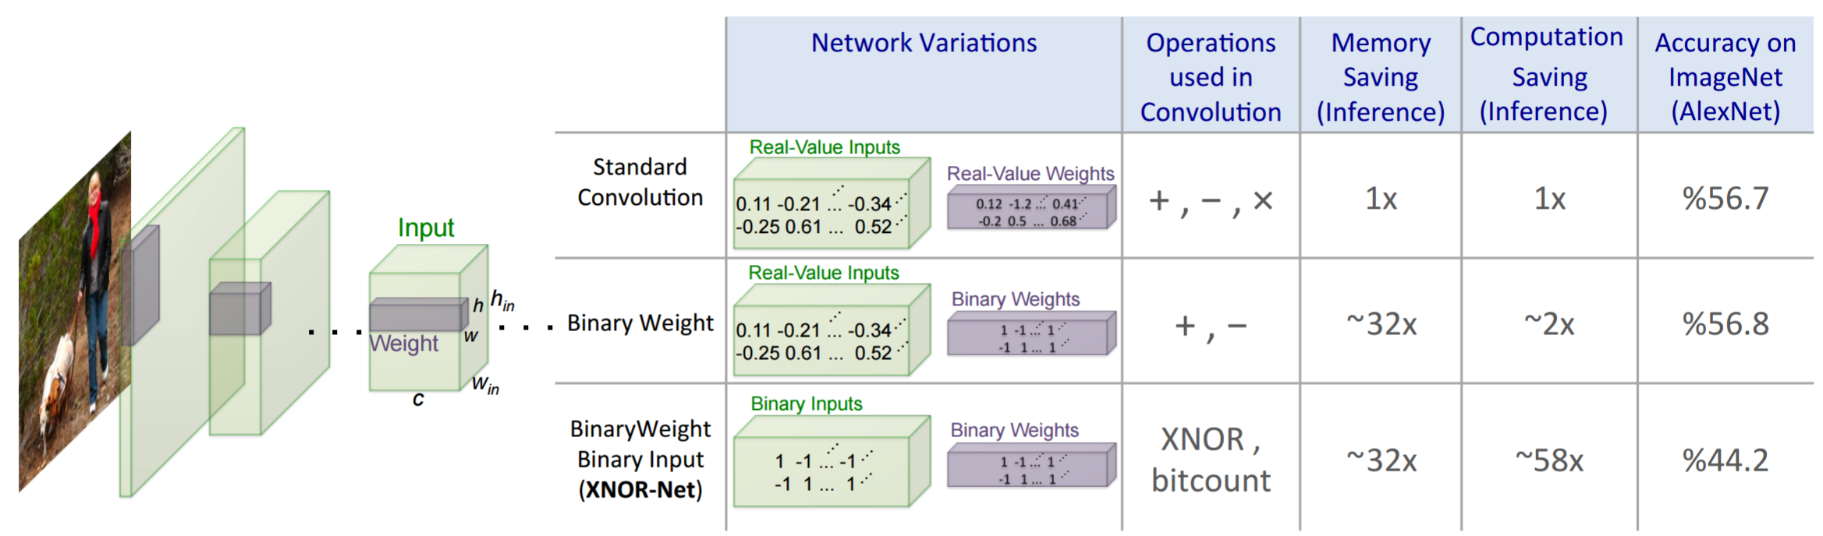
Binary weighted Networks
Idea :Reduce the weights to -1,+1
Speedup : Convolution operation can be approximated by only summation and subtraction
Mohammad Rastegari, Vicente Ordonez, Joseph Redmon, Ali Farhadi, “XNOR-Net: ImageNet Classification Using Binary Convolutional Neural Networks”
i
Notes:
Reduce weights it to binary values, then scale them during training

Slide 64
Binary weighted Networks
Idea :Reduce the weights to -1,+1
Speedup : Convolution operation can be approximated by only summation and subtraction
Mohammad Rastegari, Vicente Ordonez, Joseph Redmon, Ali Farhadi, “XNOR-Net: ImageNet Classification Using Binary Convolutional Neural Networks”
i
Notes:
Reduce weights it to binary values, then scale them during training

Slide 65
Binary weighted Networks
Idea :Reduce the weights to -1,+1
Speedup : Convolution operation can be approximated by only summation and subtraction
Mohammad Rastegari, Vicente Ordonez, Joseph Redmon, Ali Farhadi, “XNOR-Net: ImageNet Classification Using Binary Convolutional Neural Networks”
i
Notes:
Reduce weights it to binary values, then scale them during training

Slide 66
XNOR-Net
Idea :Reduce both weights + inputs to -1,+1
Speedup : Convolution operation can be approximated by XNOR and Bitcount operations
Mohammad Rastegari, Vicente Ordonez, Joseph Redmon, Ali Farhadi, “XNOR-Net: ImageNet Classification Using Binary Convolutional Neural Networks”
i

Slide 67
XNOR-Net
Idea :Reduce both weights + inputs to -1,+1
Speedup : Convolution operation can be approximated by XNOR and Bitcount operations
Mohammad Rastegari, Vicente Ordonez, Joseph Redmon, Ali Farhadi, “XNOR-Net: ImageNet Classification Using Binary Convolutional Neural Networks”
i

Slide 68
XNOR-Net
Idea :Reduce both weights + inputs to -1,+1
Speedup : Convolution operation can be approximated by XNOR and Bitcount operations
Mohammad Rastegari, Vicente Ordonez, Joseph Redmon, Ali Farhadi, “XNOR-Net: ImageNet Classification Using Binary Convolutional Neural Networks”
i

Slide 69
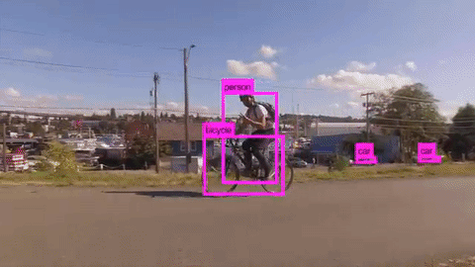
XNOR-Net on Mobile
i

Slide 70
Building a DL App and get $10 million in funding
(or a PhD)
Notes:
Now that I see this slide, this should probably have been the title for this session. We would have gotten a lot more people in this room.

Slide 71
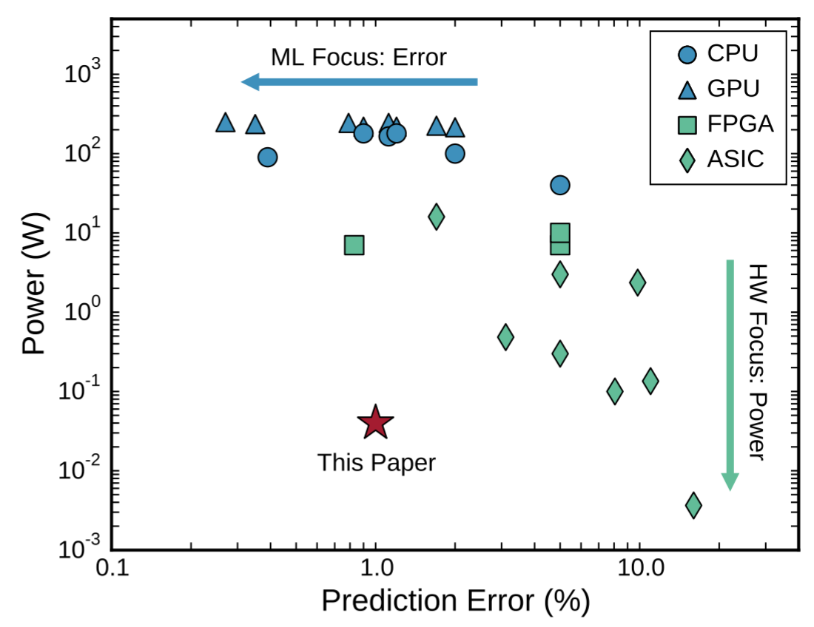
i

Slide 72
Minerva
i

Slide 73
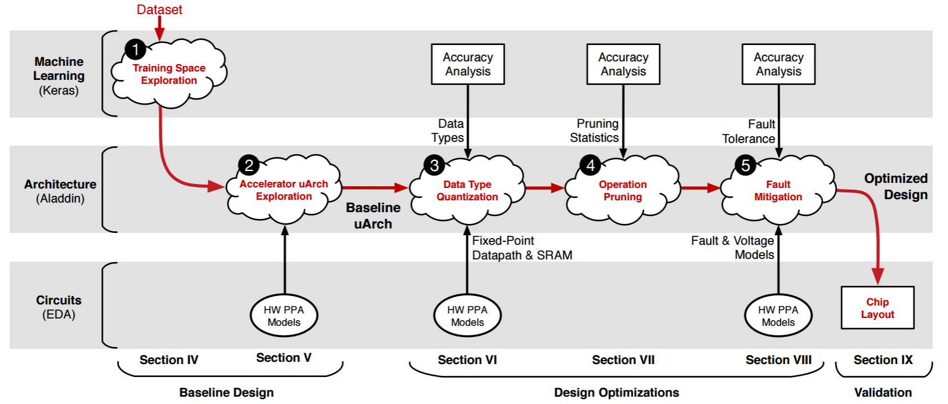
Minerva
i
Notes:
Minerva consists of five stages, as shown in Figure 2. Stages 1–2 establish a fair baseline accelerator implementation. Stage 1 generates the baseline DNN: fixing a network topology and a set of trained weights. Stage 2 selects an optimal baseline accelerator implementation. Stages 3– 5 employ novel co-design optimizations to minimize power consumption over the baseline in the following ways: Stage 3 analyzes the dynamic range of all DNN signals and reduces slack in data type precision. Stage 4 exploits observed network sparsity to minimize data accesses and MAC operations. Stage 5 introduces a novel fault mitigation technique, which allows for aggressive SRAM supply voltage reduction. For each of the three optimization stages, the ML level measures the impact on prediction accuracy, the architecture level evaluates hardware resource savings, and the circuit level characterizes the hardware models and validates simulation results.

Slide 74
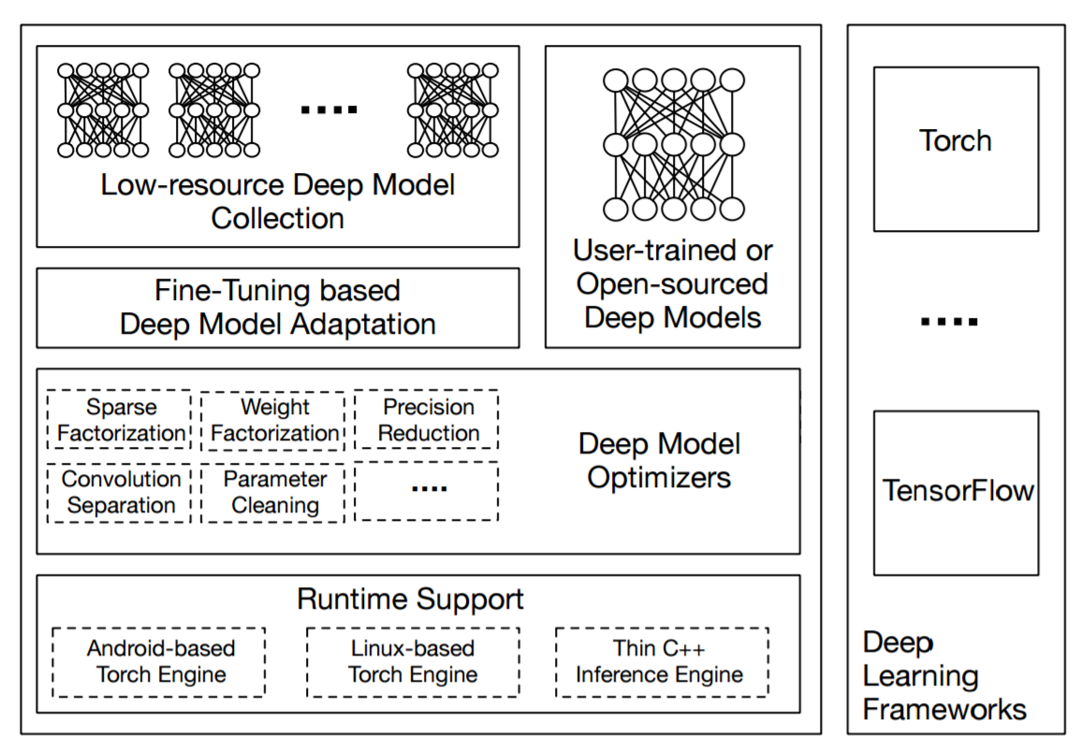
DeepX Toolkit
Nicholas D. Lane et al, “DXTK : Enabling Resource-efficient Deep Learning on Mobile and Embedded Devices with the DeepX Toolkit",2016
i

Slide 75
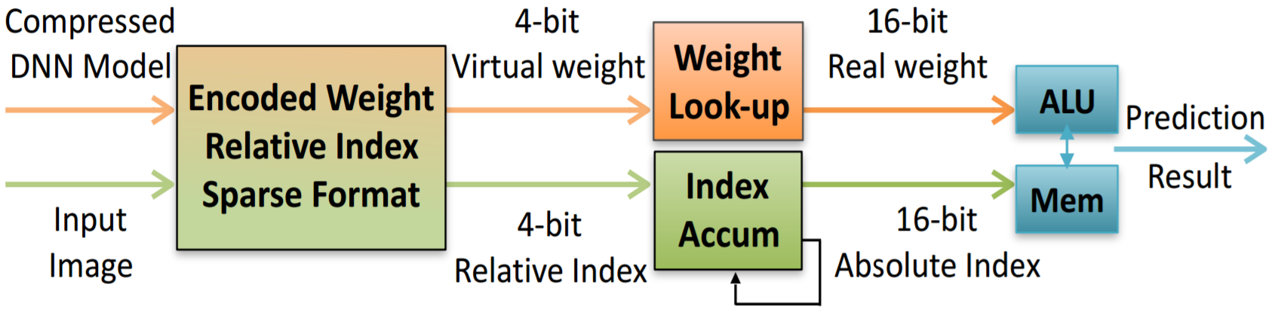
EIE : Efficient Inference Engine on Compressed DNNs
189x faster on CPU
13x faster on GPU
Song Han, Xingyu Liu, Huizi Mao, Jing Pu, Ardavan Pedram, Mark Horowitz, William Dally, "EIE: Efficient Inference Engine on Compressed Deep Neural Network", 2016
i

Slide 76
One Last Question

Slide 77

How to access the slides in 1 second
Link posted here -> @anirudhkoul

